Slide 1
CIKM tutorial
Work in progress

Slide 2
Benchmarking

Slide 3



Benchmarking: Big Fan of Metrics (EMNLP)
Clichés
Lack of Substance
Whatever you measure, you get
Be careful what you ask for
It’s difficult to make predictions, especially about the future
Yogi Berra
SOTA-Chasing
Pointless Mindless Metrics
(The point should be to make progress on a real problem)
Experimental Psychology
Validity
Reliability

Slide 4
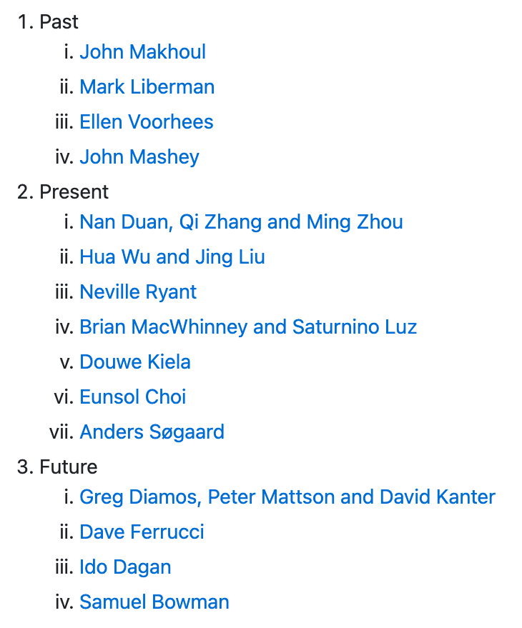

Benchmarking: Extrapolation: Past → Future
ACL-2021 Workshop
Benchmarking:
Past, Present and Future
https://github.com/kwchurch/Benchmarking_past_present_future

Slide 5

Better Together: Text + Context
https://www.semanticscholar.org/api-gallery/better-together

Slide 6
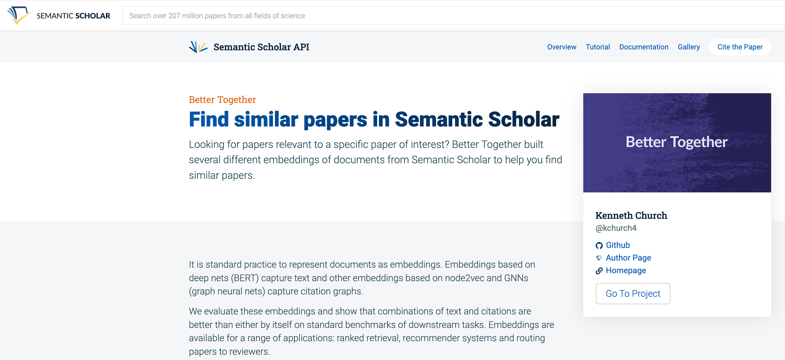
https://www.semanticscholar.org/product/api/gallery
click here

Slide 7

<return>

Slide 8

Better Together: Text (Titles, Abstracts, Body); Context (Citations)
BERT-like Deep Nets
ProNE:
Spectral Clustering

Slide 9
Opportunity: More Realistic Benchmarks
The Real World
Idealizations (Standard Benchmarks)
Large (Metcalfe’s Law)
Growing
Dirty
Missing Values
Bad/misleading Values
Small
Static
Clean

Slide 10
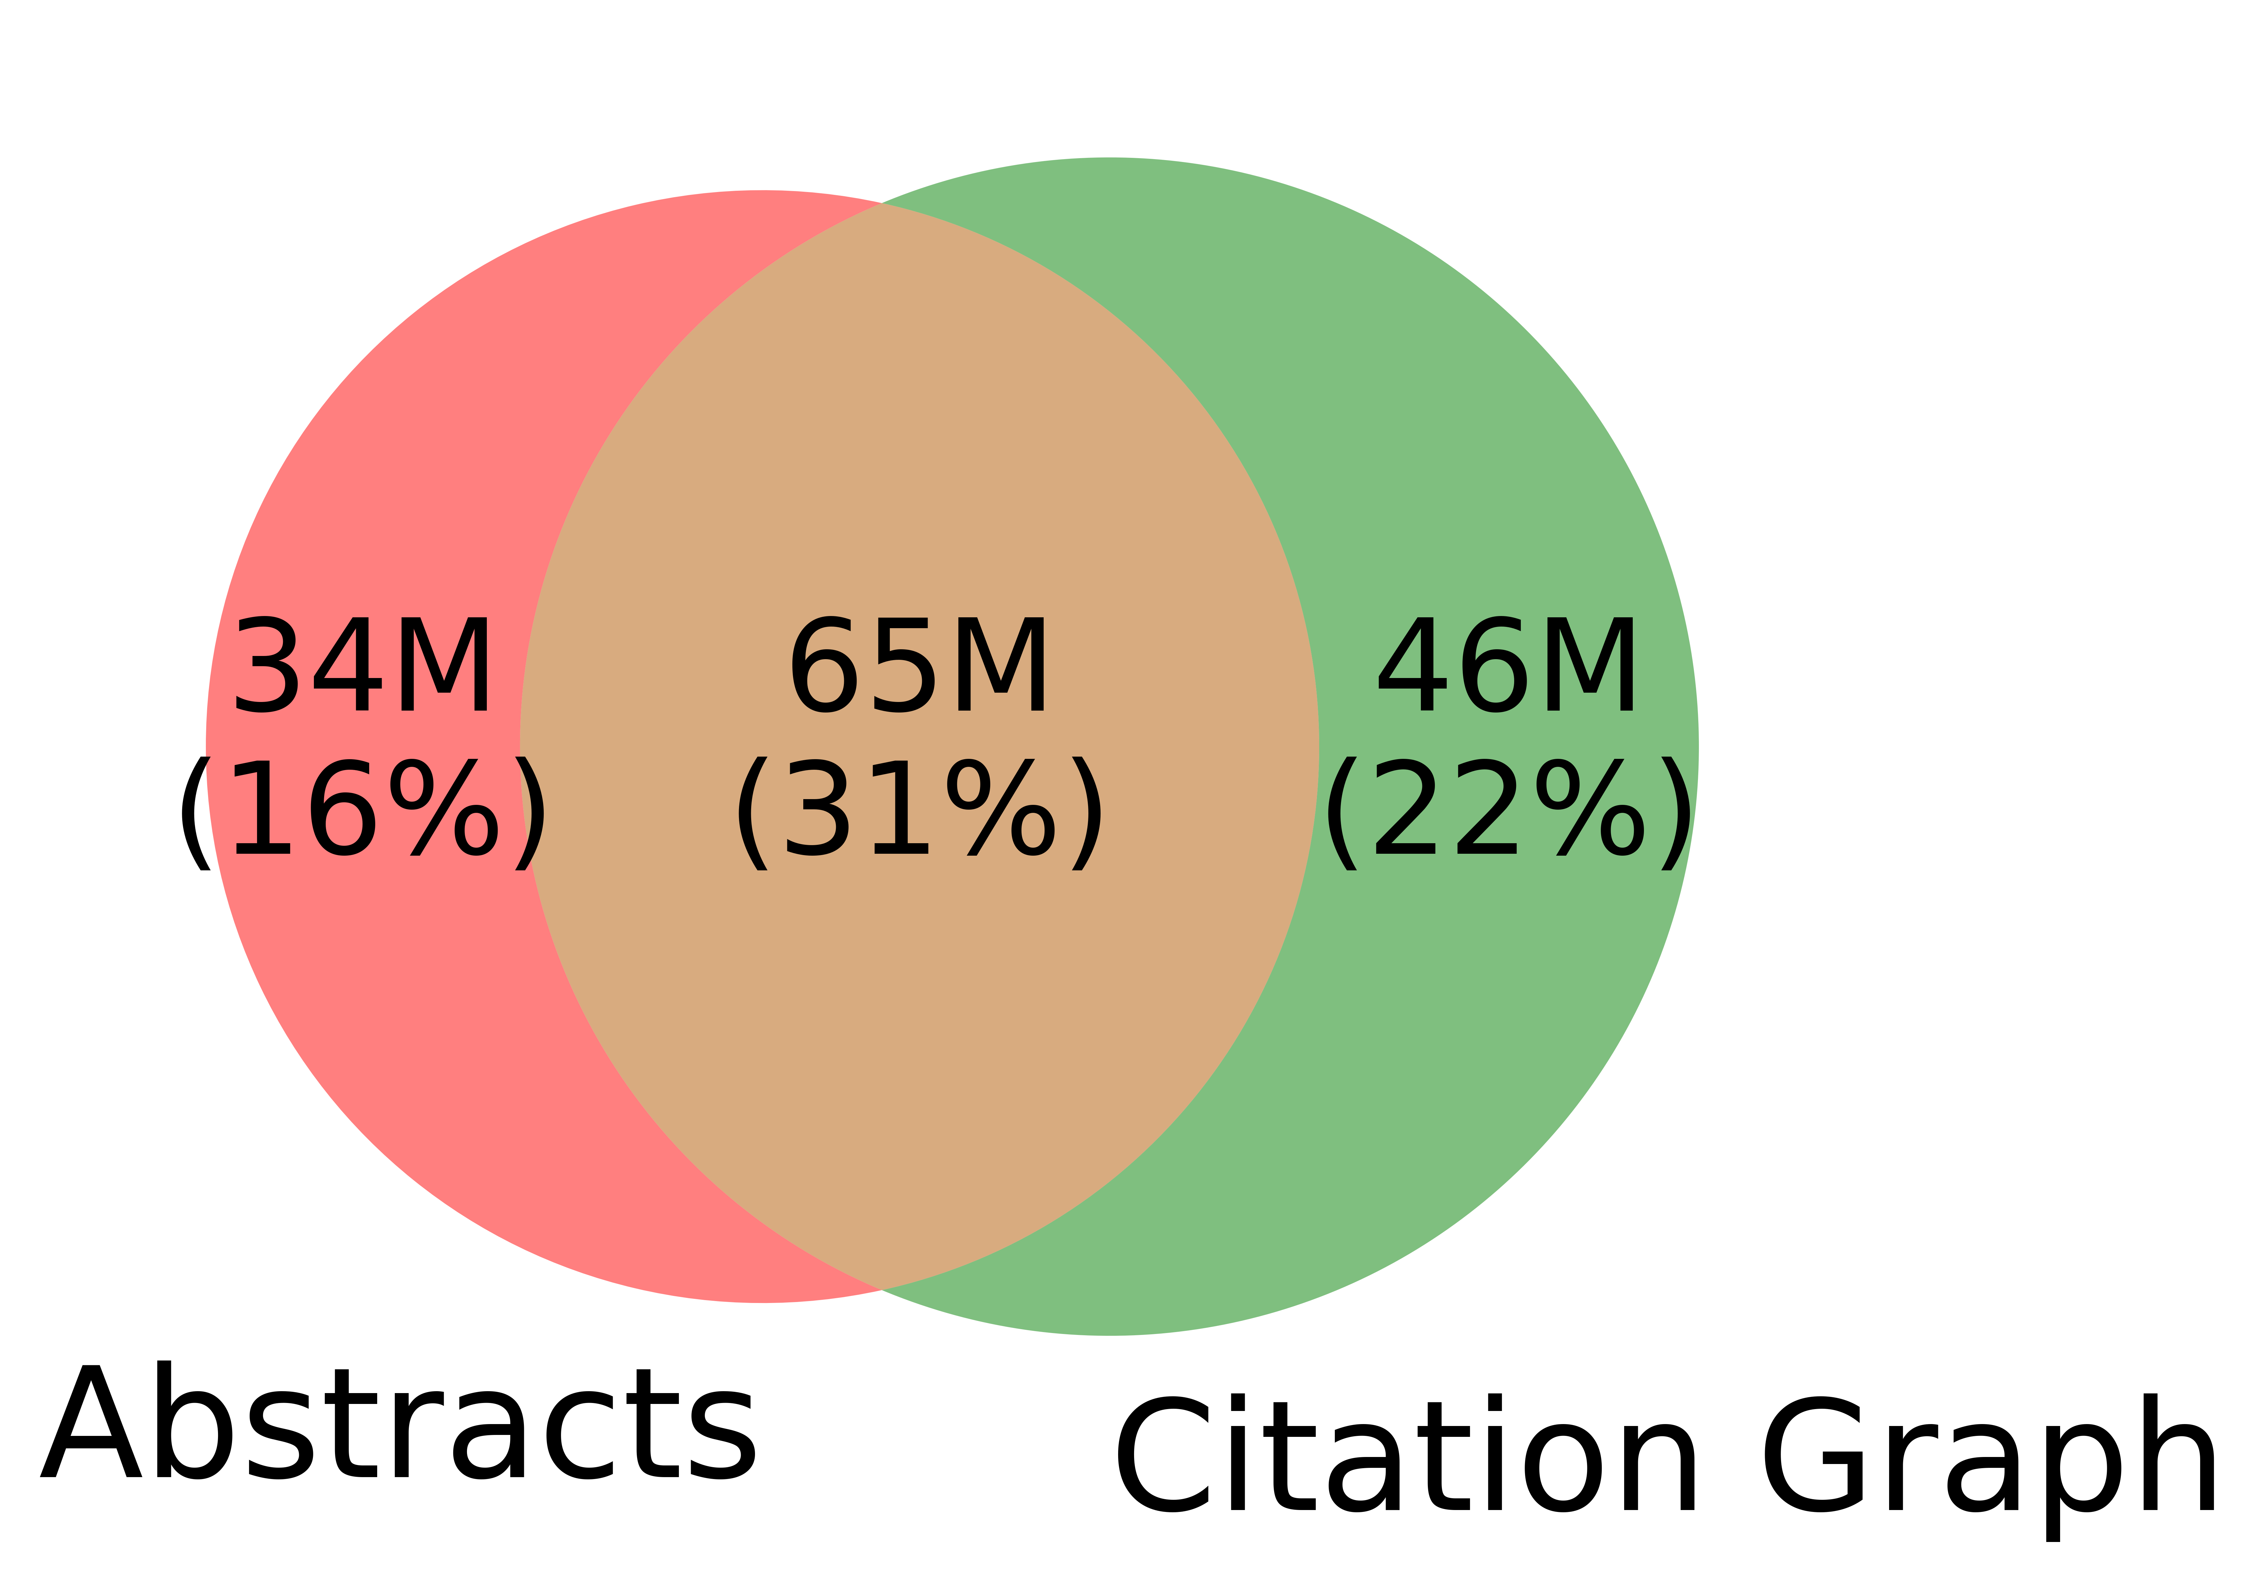
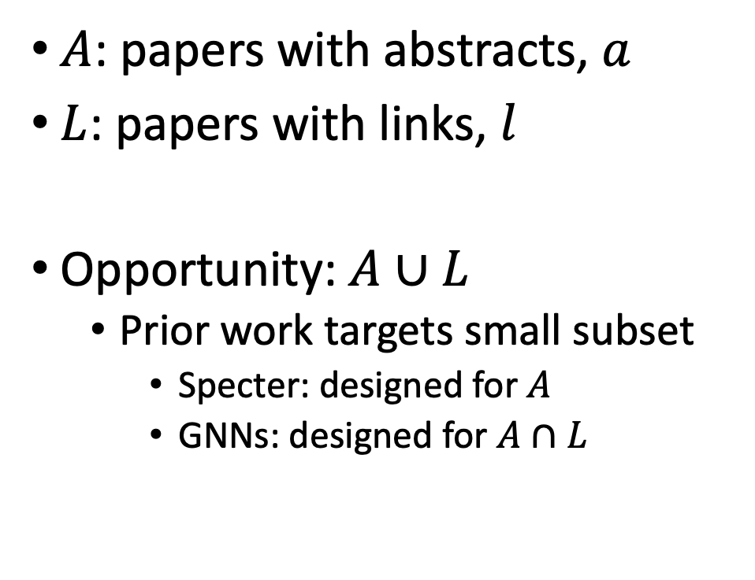
Realities (Dirty): Missing Values
$A$: papers with abstracts, $a$
$L$: papers with links, $l$
Opportunity:$A∪L$
Prior work targets small subset
Specter: designed for $A$
GNNs: designed for $A∩L$
Other
31%

Slide 11


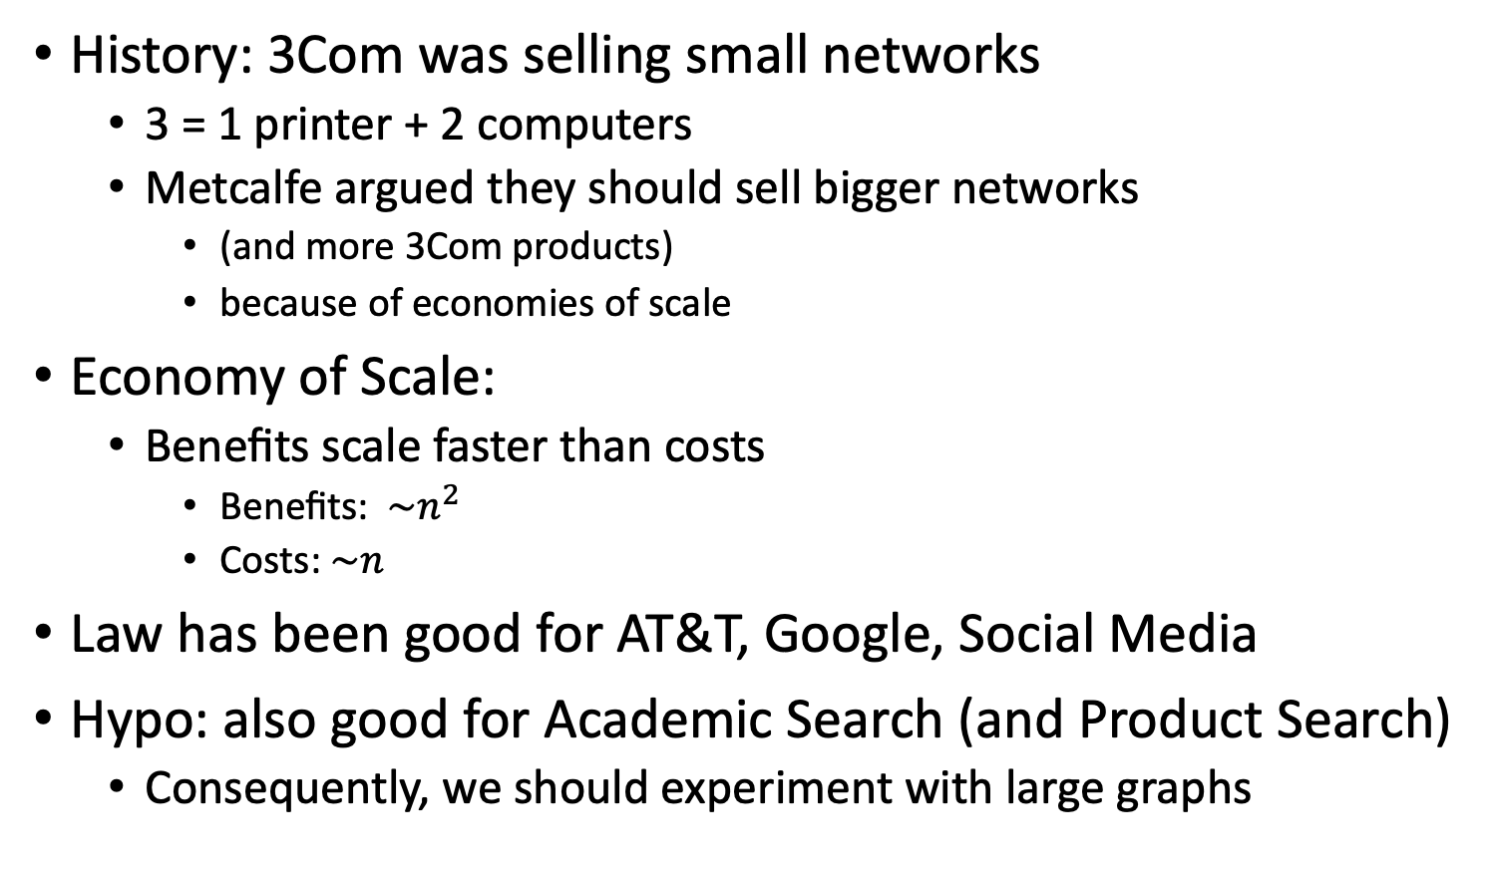
Metcalfe’s Law (Network Effects)
History: 3Com was selling small networks
3 = 1 printer + 2 computers
Metcalfe argued they should sell bigger networks
(and more 3Com products)
because of economies of scale
Economy of Scale:
Benefits scale faster than costs
Benefits: $\sim n^{2}$
Costs:$\sim n$
Law has been good for AT&T, Google, Social Media
Hypo: also good for Academic Search (and Product Search)
Consequently, we should experiment with large graphs

Slide 12
Better-Together Conjectures
Multiple representations are helpful
for missing values (and bad values)
If abstracts are missing, use links
If links are missing, use abstracts
and for graphs of different sizes
When graphs are small:
Text >> Links
when graphs are large:
Links >> Text (Metcalfe’s Law)

Slide 13
Opportunities
Scale
Prediction
Many benchmarks return a single number (figure of merit)
How does performance scale
with the size of the problem?
Standard test/train splits
More relevant to interpolation
than extrapolation
Time is asymmetric
It is difficult to make predictions
especially about the future
-- Yogi Berra

Slide 14
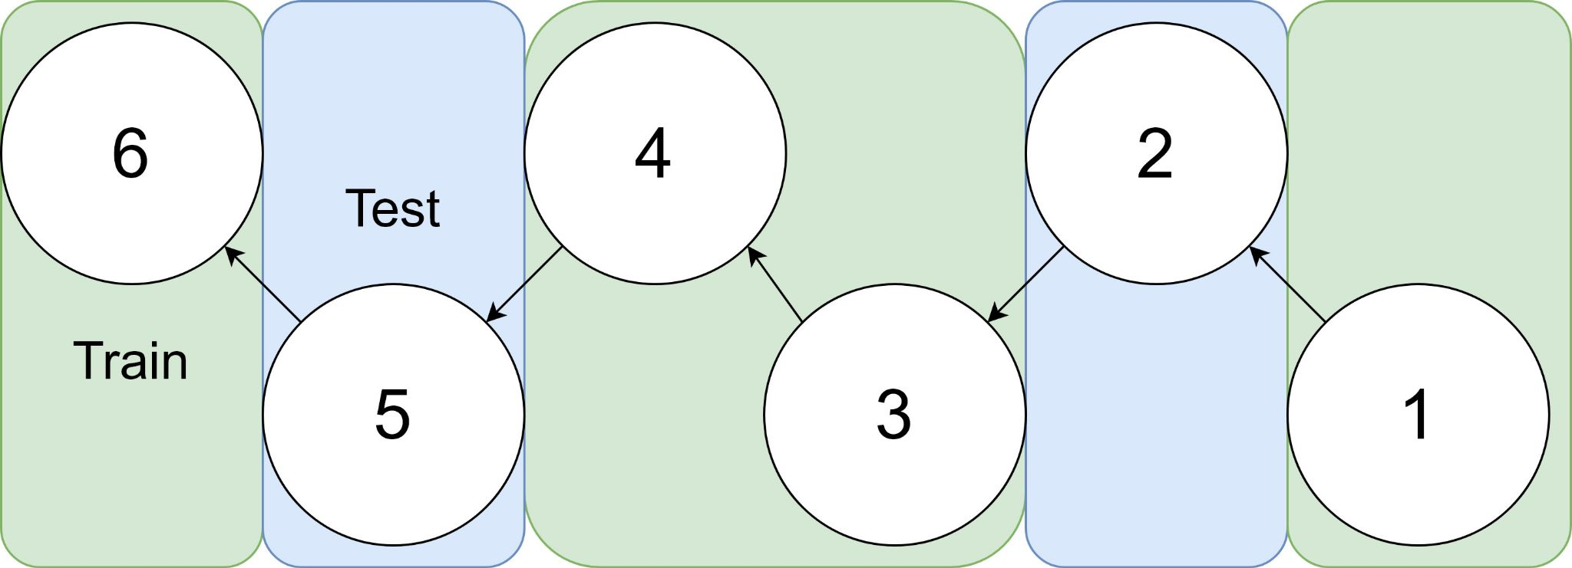
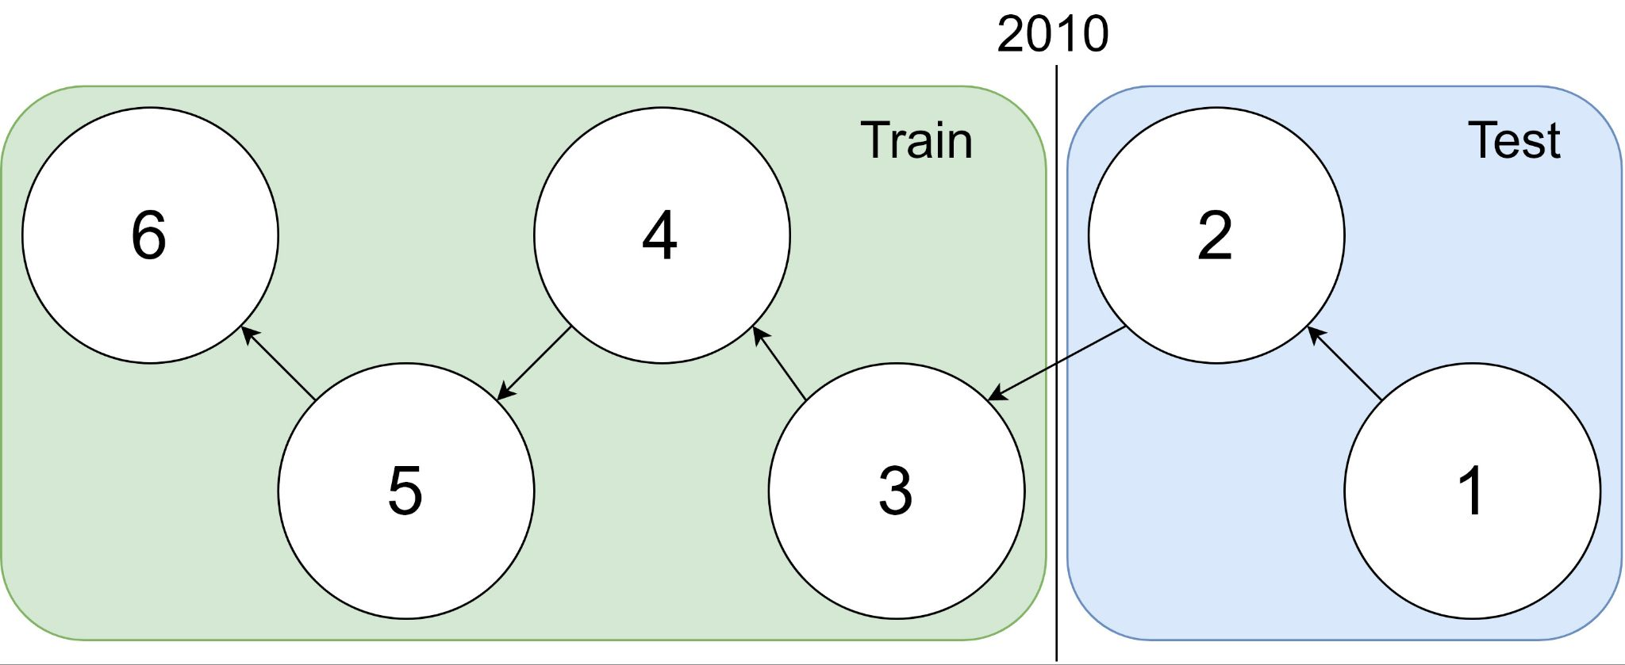
Example: 1 cites 2, 2 cites 3, … 5 cites 6
Traditional Train-Test Split (Non-Causal)
idx | Pub Year | Paper Title
1 | 2018 | [...] Photofragment imaging
2 | 2016 | Convenient probe of S(1D2)[...]
3 | 2005 | Megapixel ion imaging [...]
4 | 2003 | Direct current slice imaging [...]
5 | 1995 | profiles of Cl(2Pj) photofragments [...]
6 | 1988 | Adiabatic dissociation of [...]
Proposed Train-Test Splits (Causal)
Notes:
No asymmetry of time - how to reduce to a soundbite
Audience soundbites
‘Almost all studies in ml do test-train split’ that’s a bad idea when you have time

Slide 15
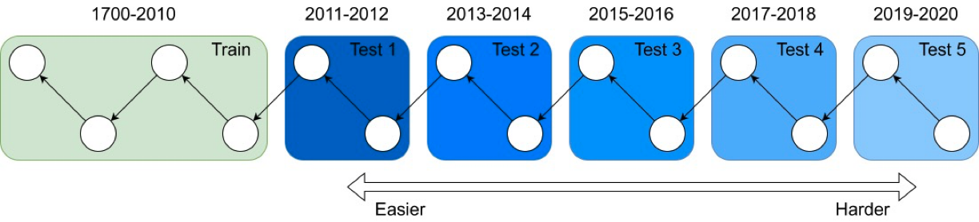
It's tough to make predictions, especially about the future ― Yogi Berra
Forecasting: short-term predictions are easier than long-term

Slide 16
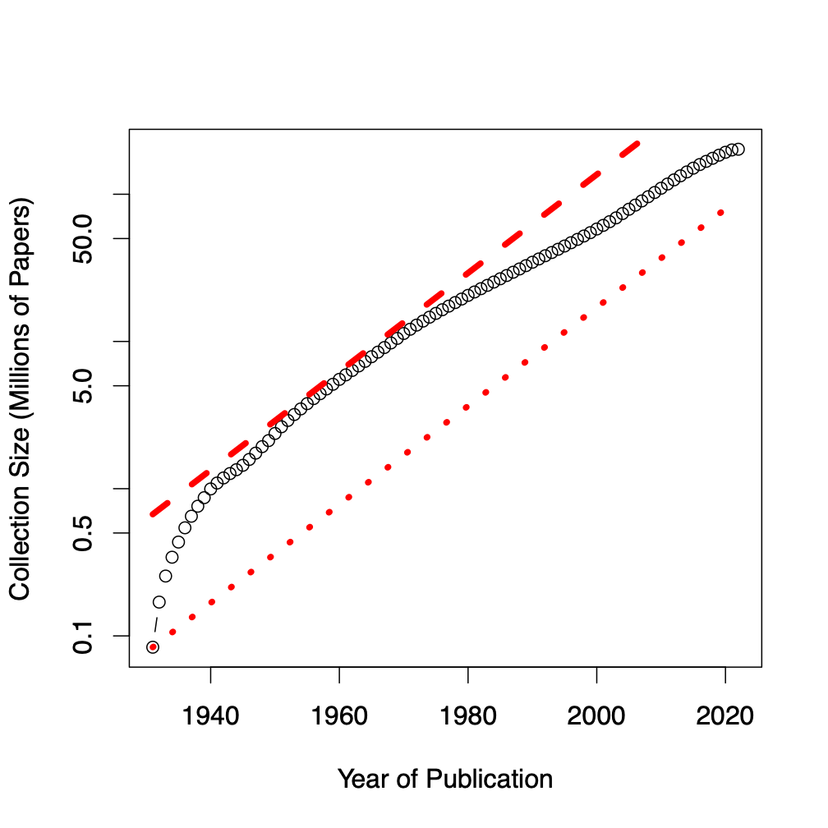
Assign 200M papers to 100 bins (by time)
Sort 200M papers by publication date
Output: Split papers into 100 bins, with 2M papers/bin
Because of exponential growth
(literature doubles every 9 years)
older bins span more time, and
newer bins span less time
Bin 99
………
Bin 0
Time
Notes:
mention equal # papers
consider replacing w/ diagram

Slide 17
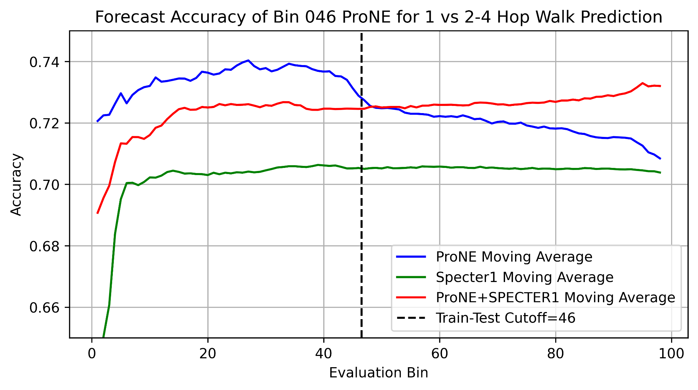
Better Together Observations
ProNE (Context) >> Specter (Text)
Ensembles are better
than either by itself
Text is most helpful
when links are not working well
i.e., long-term forecasting

Slide 18
Benchmarking Take-Aways More Realistic Benchmarks
The Real World
Idealizations (Standard Benchmarks)
Large (Metcalfe’s Law)
Growing
Dirty
Missing Values
Bad/misleading Values
Small
Static
Clean

Slide 19

Two Perspectives on Datasets
Machine Learning
Psychology (Presupposes $∃$Hypothesis)
Splits: train/val/test
Treat rows as iid
Identical and independently distributed
Idealistic, but maybe unrealistic
Changes over time, Context, etc.
More papers on models
than Datasets
Relatively little interest in
Is the Dataset Realistic?
Motivation? (Does anyone care? If so, who?)
What is the dataset testing?
Sampling/balance? From which population?
Can it be gamed? Leakage?
Validity
Content validity
Construct validity
Criterion validity
Face validity
Discriminant validity
Reliability
Inter-rater reliability
Test-retest reliability
Internal reliability/Inter-item consistency
Split half reliability
Lexicography

Slide 20
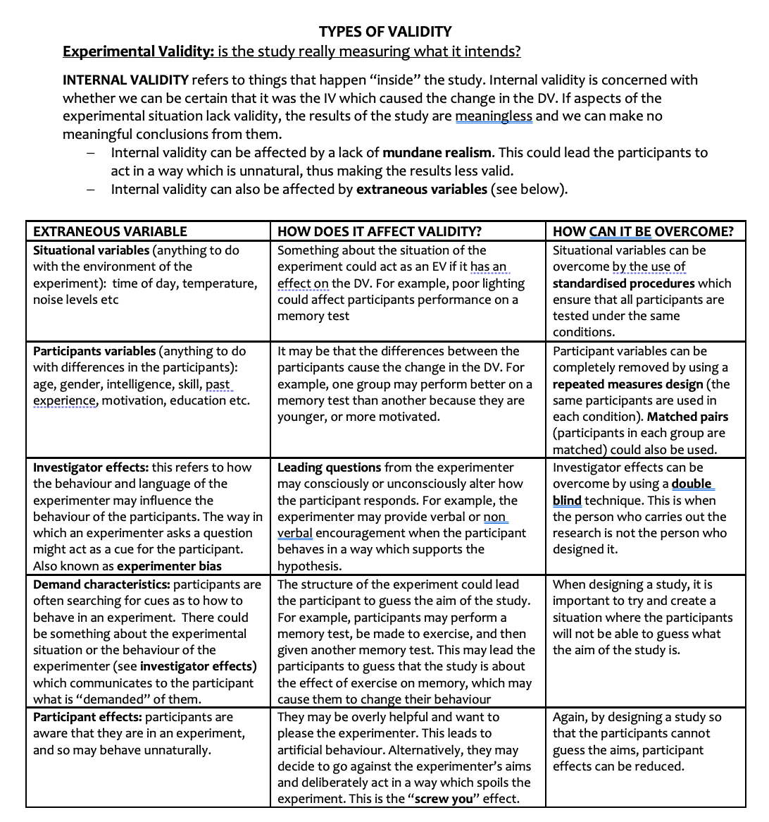
Discussion of Validity Assumes: Intention

Slide 21
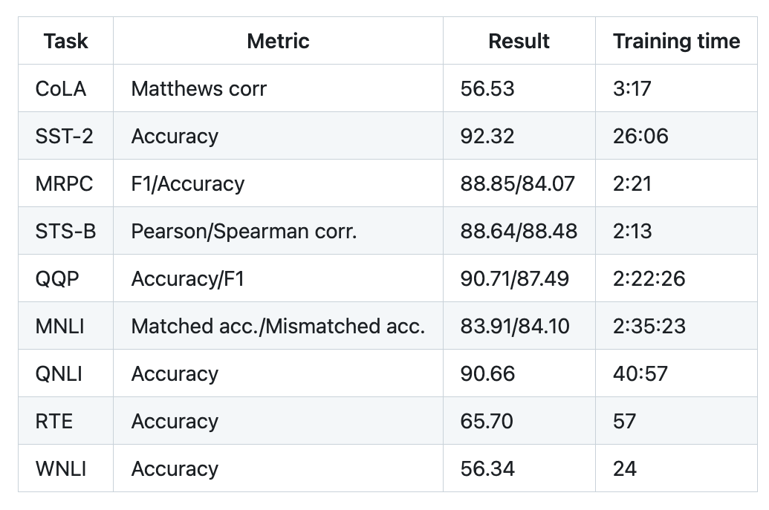
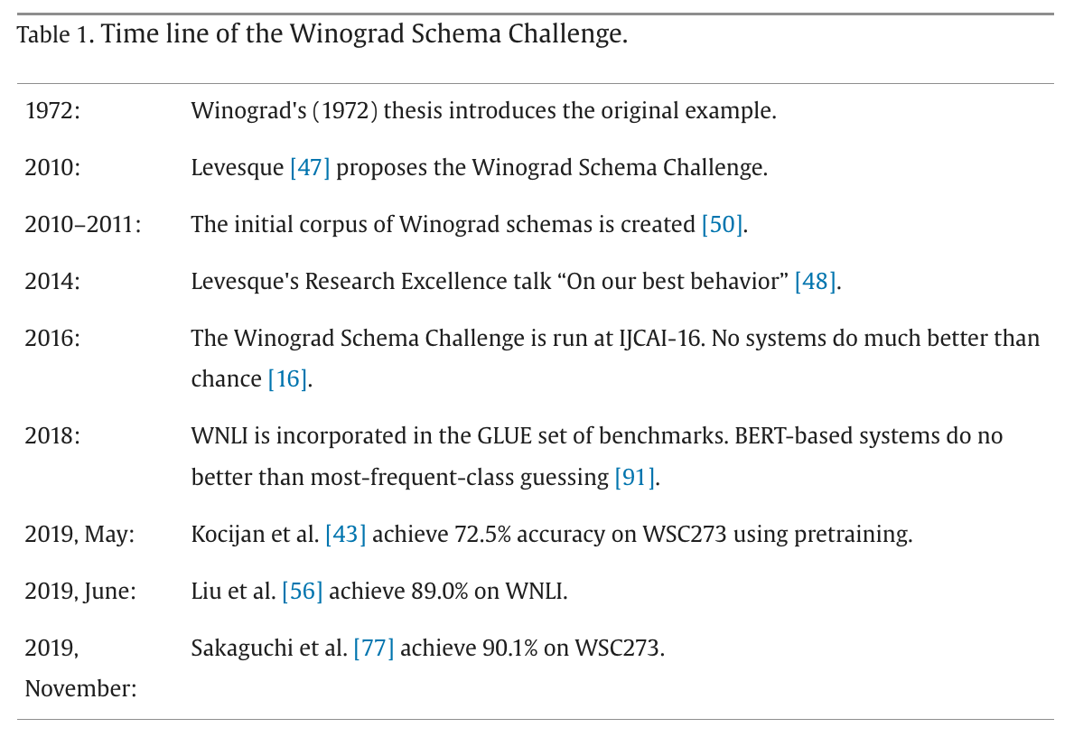
Winograd Schema (GLUE WNLI)
The trophy doesn't fit in the brown suitcase
because it is too large.
What is too large?
A. The trophy
B. The suitcase
Not much better than chance
from: https://doi.org/10.1016/j.artint.2023.103971

Slide 22

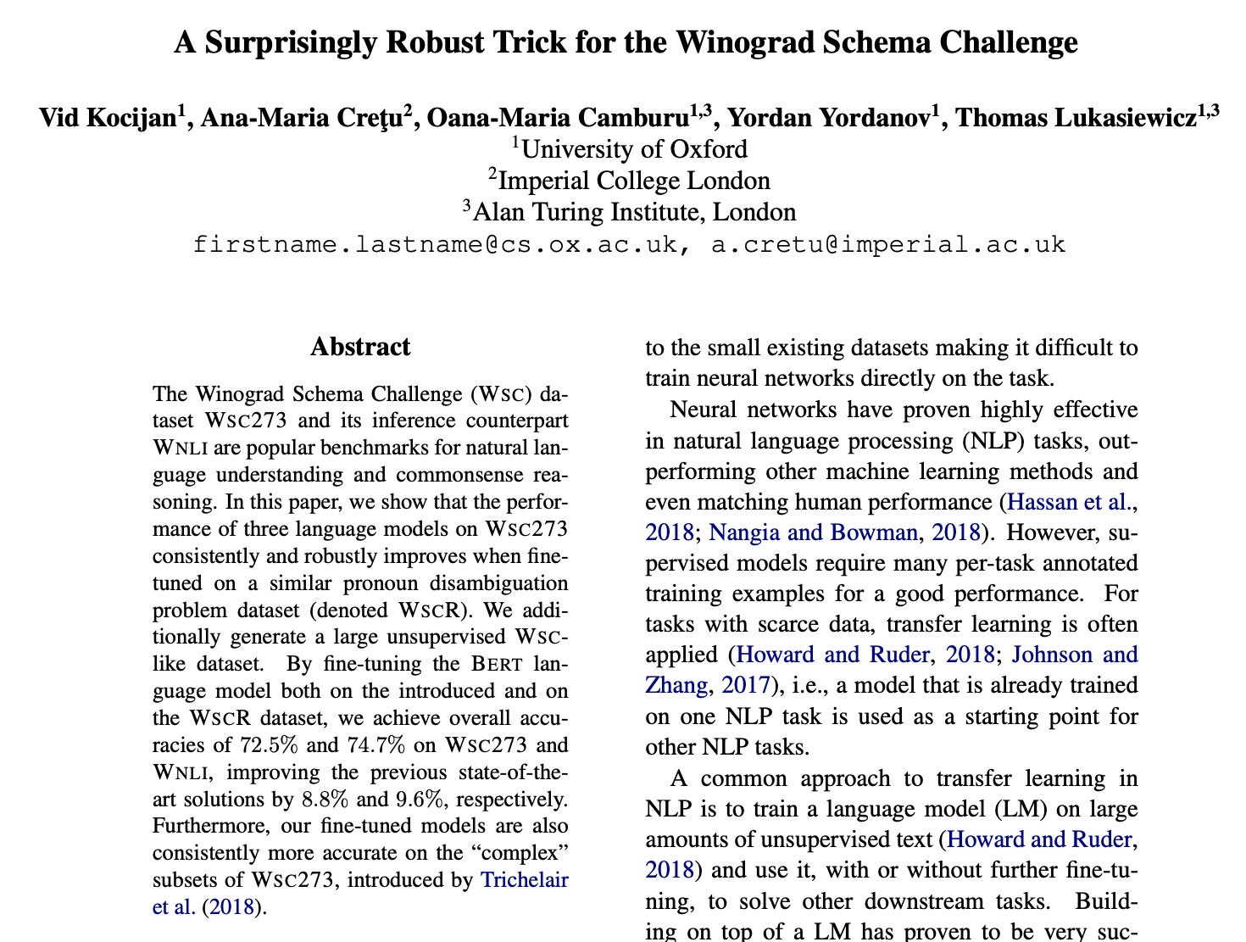
Winograd Schema (GLUE WNLI)

Slide 23
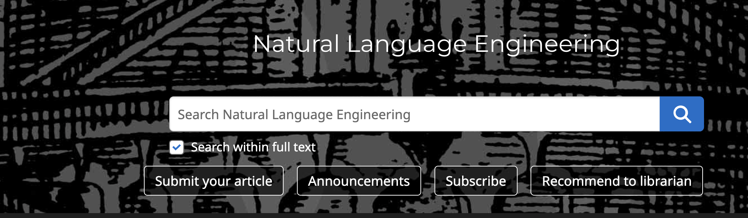
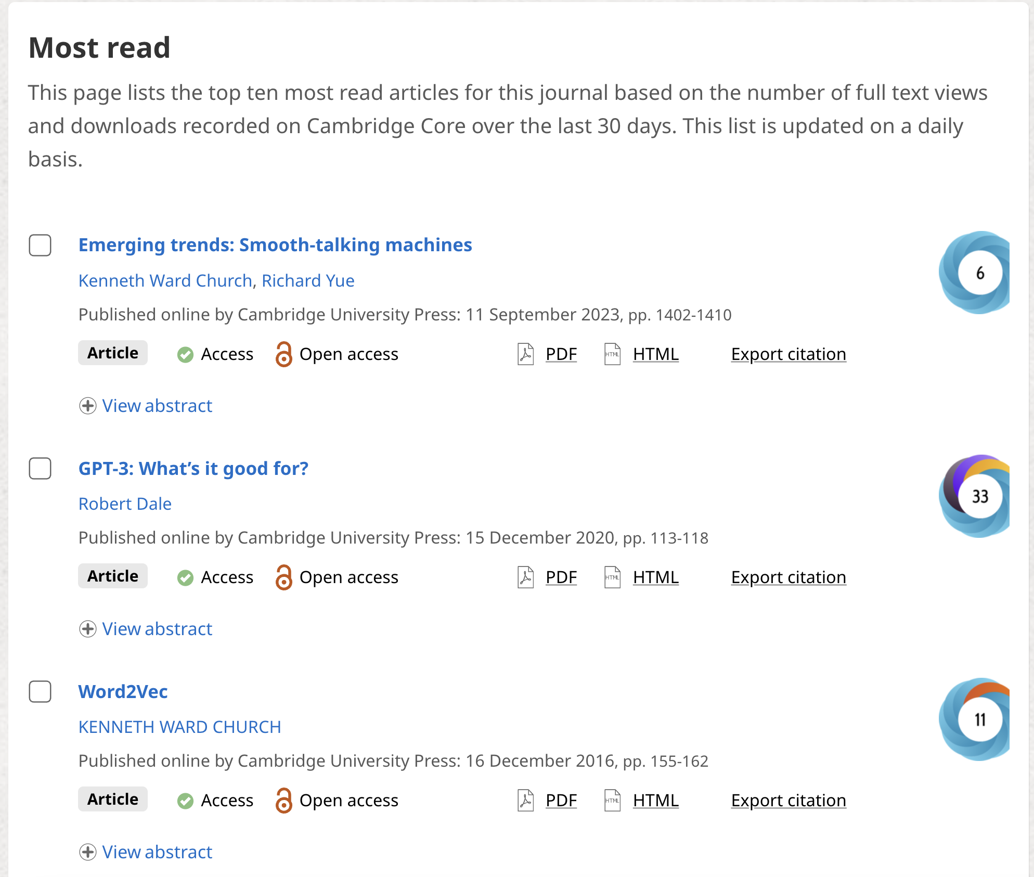
Shameless Plug: Smooth-Talking Machines

Slide 24

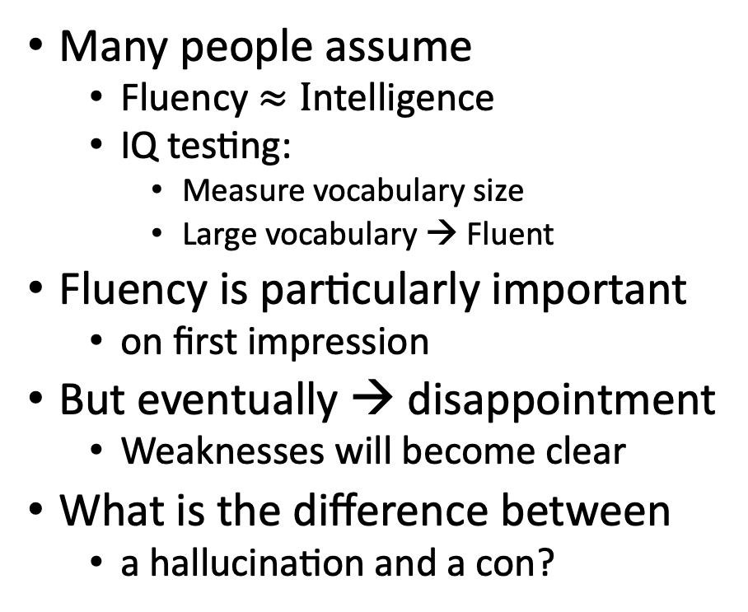

Challenge: Fluency $≠$ Trustworthiness
A number of articles on ChatGPT
lead with amazing successes
that seem too good to be true,
and end with back-peddling
ChatGPT has
amazing strengths (fluency)
as well as
amazing weaknesses (trustworthiness)
Many people assume
Fluency $≈I$ntelligence
IQ testing:
Measure vocabulary size
Large vocabulary → Fluent
Fluency is particularly important
on first impression
But eventually → disappointment
Weaknesses will become clear
What is the difference between
a hallucination and a con?

Slide 25
What should we do next?
Three paths forward:
Low road:
Give up (hallucinations)
Middle road:
Fact-checking with search
High road:
Revive rationalism (“AI Complete”)
Minsky & Chomsky
Recommendations
Short-term:
Middle Road: Search
“Good apps for Crummy MT”
Find apps for what we have
given strengths and weaknesses
Long-term:
High road may be necessary
But it is very ambitious
Inclusiveness:
Interdisciplinary Collaboration
Growth opportunities
(Low Resource Languages)

Slide 26

Hypothesis: NLP History → Strengths & Weaknesses
Deep Nets are
more fluent
than trustworthy
Pendulum Swung Too Far (2011)
Empiricism (1950s)
Rationalism (1970s)
Empiricism (1990s)
Deep Nets (2010s)
Truth
Fluency
Fluency
Fluency

Slide 27
Massive Growth → Mistaken Impression that everything is new (and there is no history)
Scientific Literature doubles every 9 years (90% written since I started PhD)
What’s new
The world is taking notice (in AI)
Fluency is much improved
What’s not new
Chatbots (and much of the tech)
SOTA-Chasing
New/better shiny objects
(with same old quality?)
Does SOTA-Chasing → Progress?
Trustworthiness is still wide open

Slide 28
Personal History
Strengths (fluency) and weaknesses (trustworthiness)
may be a consequence of choices we made in 1990s
We started EMNLP in 1990s for pragmatic reasons
Field had been attempting to do too much
and was accomplishing too little
(during a funding winter)
We chose to stop working on hard problems
(trustworthiness)
in order to make relatively quick progress on fluency
by reviving empirical methods from the 1950s
(Shannon, Skinner, Firth)
Deep Nets are
more fluent
than trustworthy
Pendulum Swung Too Far (2011)
Empiricism (1950s)
Rationalism (1970s)
Empiricism (1990s)
Deep Nets (2010s)
Fluency
Fluency
Fluency
Truth

Slide 29

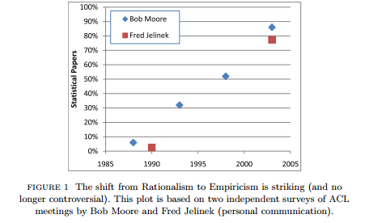
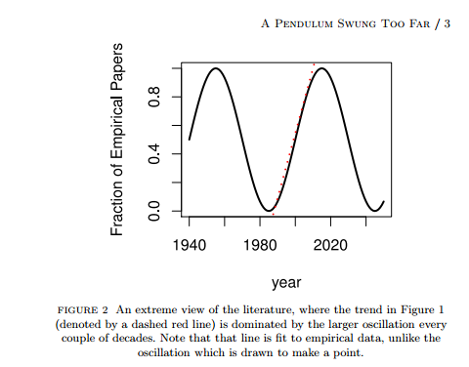
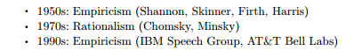
Pendulum Swung Too Far ChatGPT’s strengths (fluency) and weaknesses (trustworthiness) may be a consequence of choices we made in 1990s
Mechanism
We started EMNLP

Slide 30

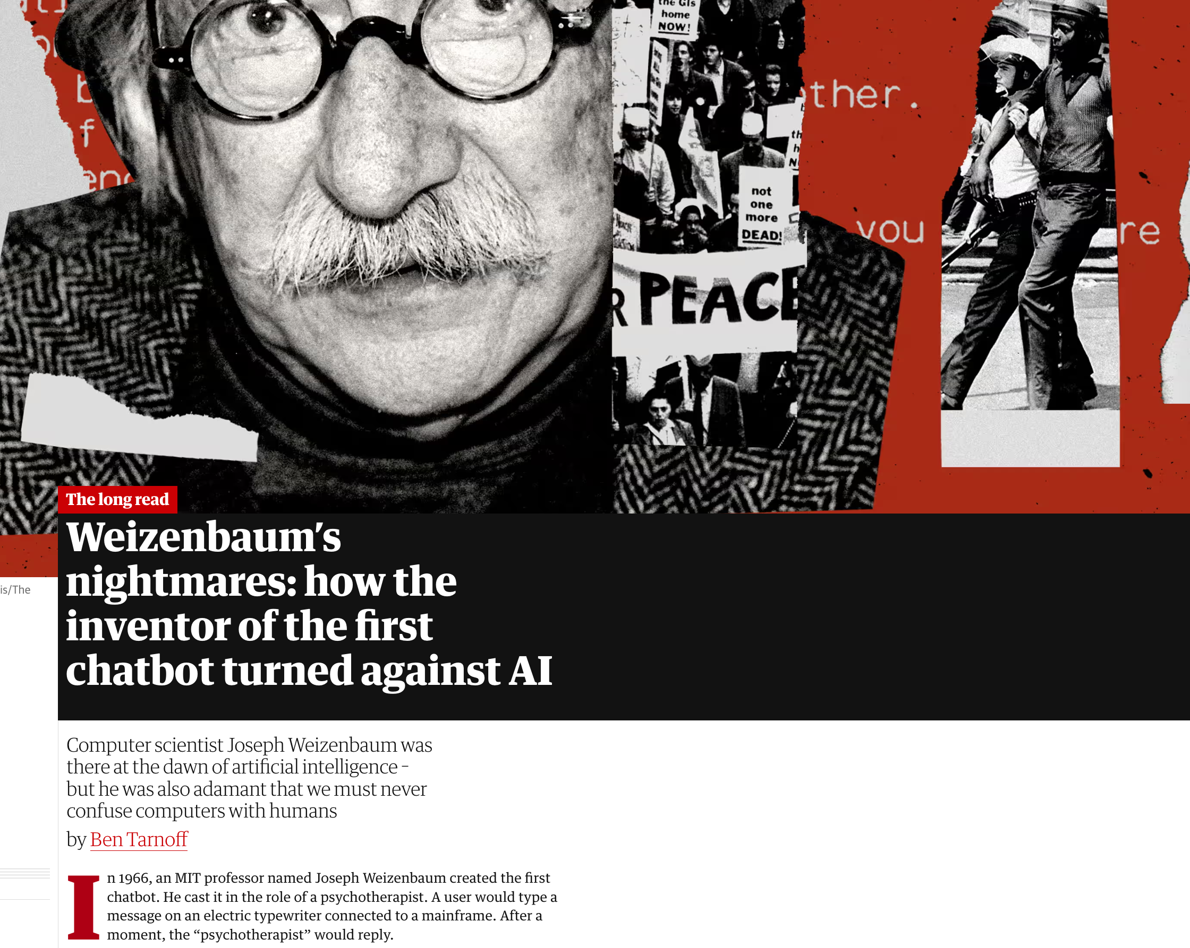
History does not repeat itself (but it rhymes)
Recent article in Guardian
Compared ChatGPT and Weizenbaum's ELIZA
https://www.theguardian.com/technology/2023/jul/25/joseph-weizenbaum-inventor-eliza-chatbot-turned-against-artificial-intelligence-ai
As a TA for Weizenbaum (1978),
I know just how horrified he was
by how seriously people took ELIZA
Responsible AI
His views were not popular at MIT
at the time

Slide 31
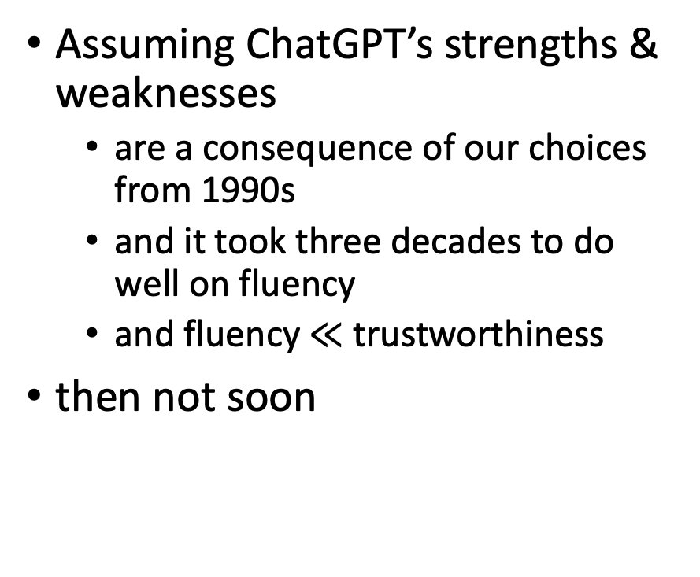
How Hard are Hallucinations? Yogi Berra
Possible answers:
Soon: “See next release”
Eventually, but not soon:
“Next Year in Jerusalem”
History of Machine Translation (MT)
When will MT be practical?
Prediction from 1950s: 5 years
Never
Assuming ChatGPT’s strengths & weaknesses
are a consequence of our choices from 1990s
and it took three decades to do well on fluency
and fluency $≪$ trustworthiness
then not soon

Slide 32
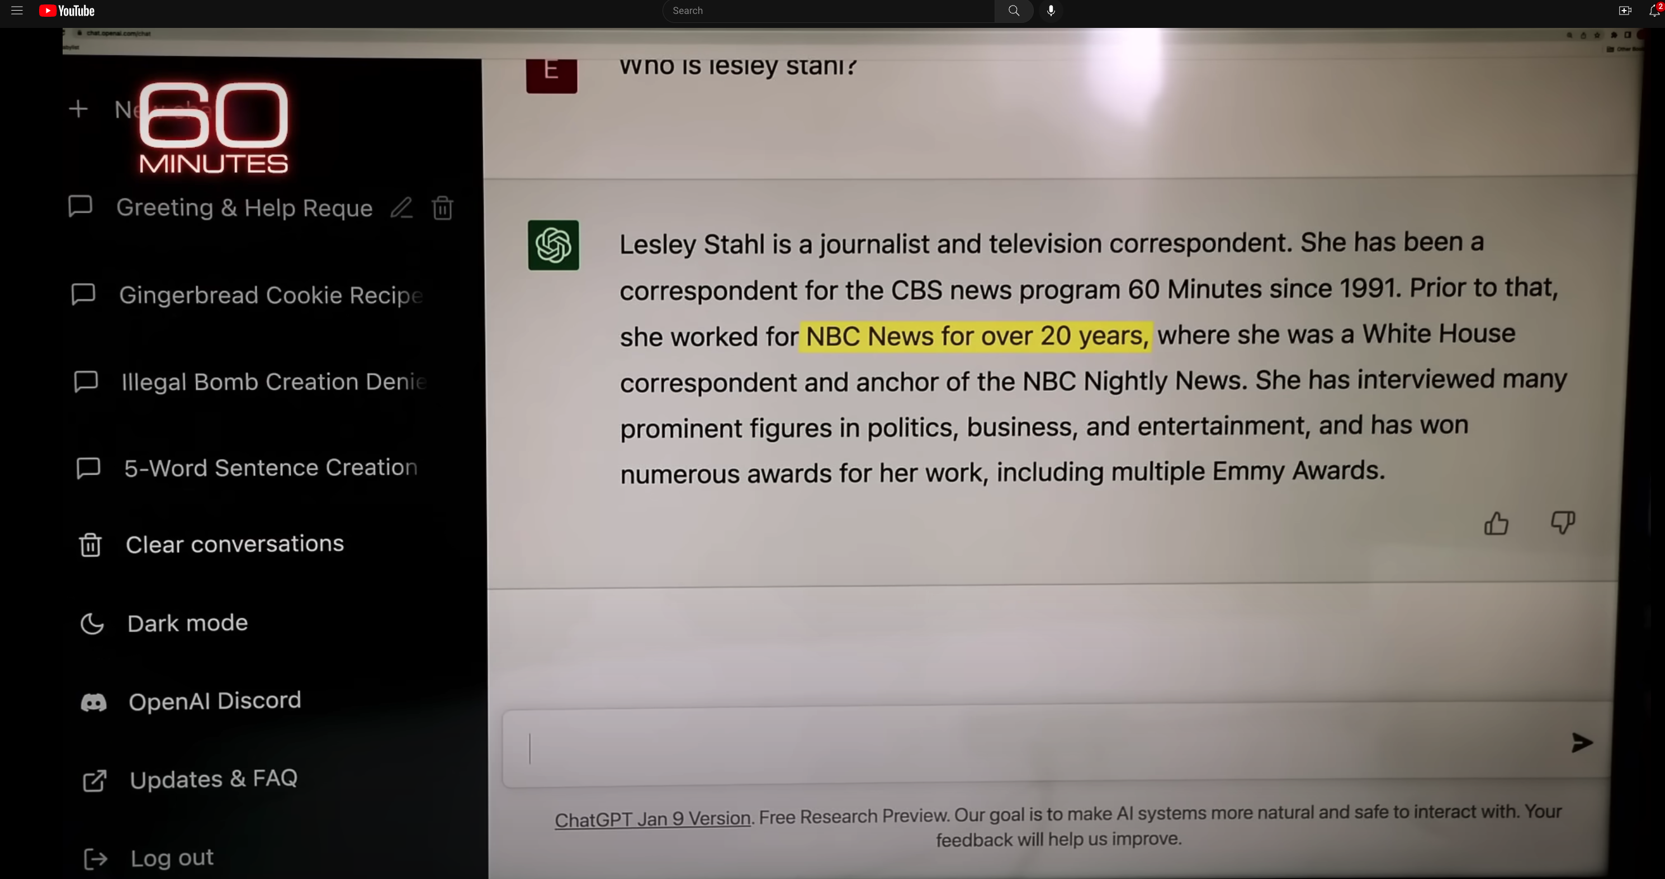

ChatGPT Hallucinates on CBS ``60 Minutes’’ https://www.youtube.com/watch?v=1wzPr4cUoMQ&t=463s
Prompt
Hallucination
https://github.com/kwchurch/ACL2022_deepnets_tutorial
32

Slide 33
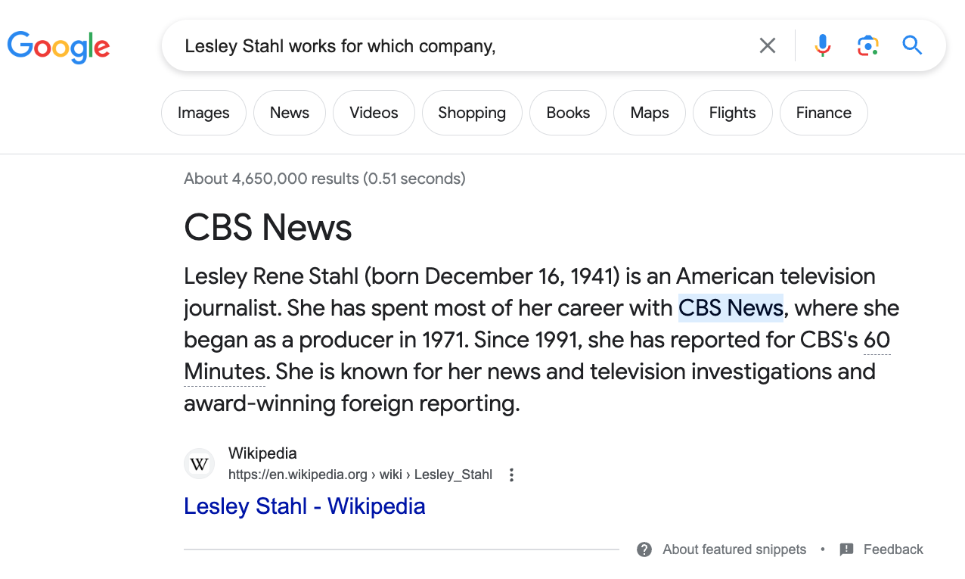
Constructive Suggestions for Hallucinations
Query: Lesley Stahl works for which company
Low Road:
Give up
Middle Road
Fact-checking with search
High Road
Revive Rationalism
CBS

Slide 34
Challenges for Fact-Checking
Which claims need to be checked?
How do we create queries?
When we get search results, then what?

Slide 35
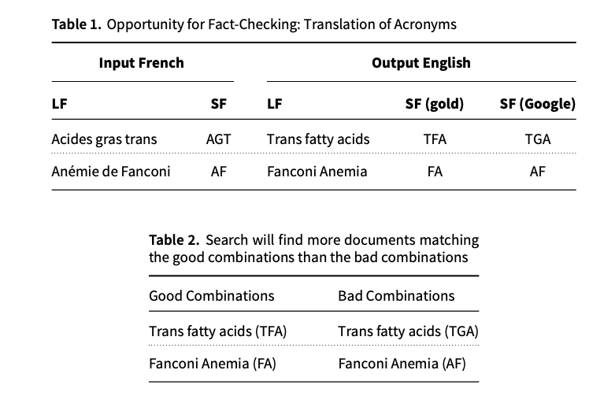
Acronyms: A Simple Case for Fact-Checking
Acronyms are easier
Google Translate is better on long forms (LFs) than short forms (SFs)
Use Google to translate LFs to target language (English)
Generate candidate SFs in target
Use search to verify candidates
Co-author (Richard Yue)
used to be a professional translator
Metrics matter:
Terminology:
important to translators
(But less so for BLEU)
De nombreux facteurs de risque participent au développement de cette pathologie, parmi lesquels les acides gras trans (AGT).
... une diminution d’expression de 12 gènes mutés dans l’anémie de Fanconi (AF)

Slide 36
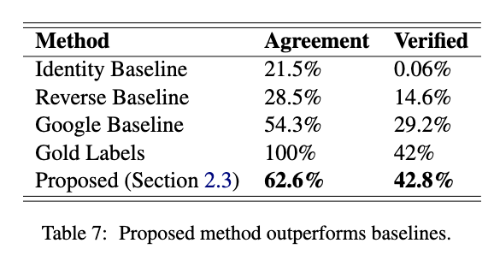
Fact-Checking Take-Aways
Short-term patch for hallucinations
Acronyms:
Easy special case of hallucinations
Don’t re-invent the wheel
Re-use existing tools: Search
Standard Loss/Metrics
Insufficient Penalty for Fatal Errors
Terminology
Responsible AI
Agreement:
hyp = gold
Verification:
Search finds 2+ examples in publications

Slide 37
Simple Example: Arithmetic (Chomsky: Capturing Relevant Generalizations)
Hypothetical
Is this progress?
Suppose ChatGPT
can add two small numbers
But for large numbers,
it makes up answers
After each release,
“small” gets “bigger”
Empiricism
According to SOTA-Chasing,
Yes
Rationalism
According to Minsky & Chomsky,
No
ChatGPT is not mastering concepts
“Stochastic Parrots”

Slide 38
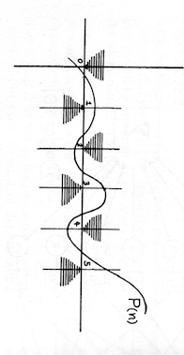


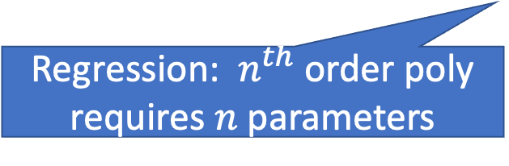
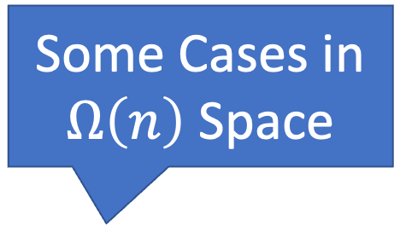
Perceptron: “Can’t Compute Parity” (Capturing Relevant Generalizations)
All Cases in
$O\left(1\right)$ Space
0
0
1
Some Cases in
$Ω\left(n\right)$ Space
Even
Odd
1
Minsky rejects deep nets (1969)
Regression: $n^{th}$ order poly requires $n$ parameters

Slide 39
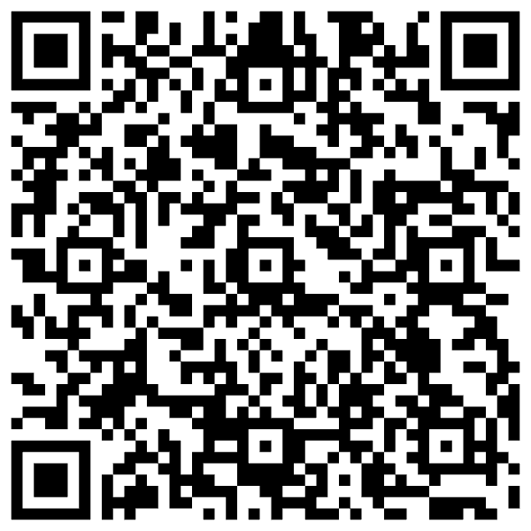
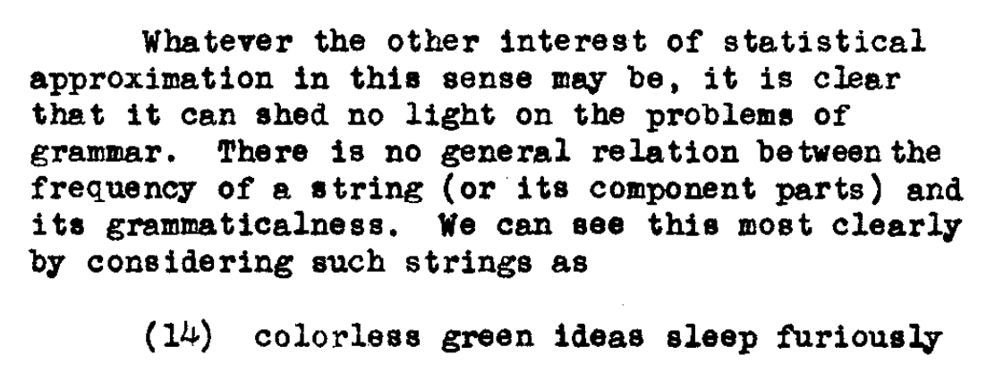
N. Chomsky, "Three models for the description of language," in IRE Transactions on Information Theory, vol. 2, no. 3, pp. 113-124, September 1956, doi: 10.1109/TIT.1956.1056813
Minsky rejects deep nets (1969)
Introduced Chomsky Hierarchy:
Finite State → Turing Machines

Slide 40

Capturing Generalizations Argument
Pros
Cons
Long-Term Focus
Can’t get to moon by
Incremental short-term local optimization
Dismisses Short-term Progress
Sometimes it is useful
to solve some simple special cases
(addition of small numbers)
Not constructive:
“MIT School of Negativity”

Slide 41
Personal History
ChatGPT’s strengths (fluency) and weaknesses (trustworthiness)
may be a consequence of choices we made in 1990s
We started EMNLP in 1990s for pragmatic reasons
Field had been attempting to do too much
and was accomplishing too little
(during a funding winter)
We chose to stop working on hard problems (trustworthiness)
in order to make relatively quick progress on fluency
by reviving empirical methods from the 1950s (Shannon, Skinner, Firth)

Slide 42
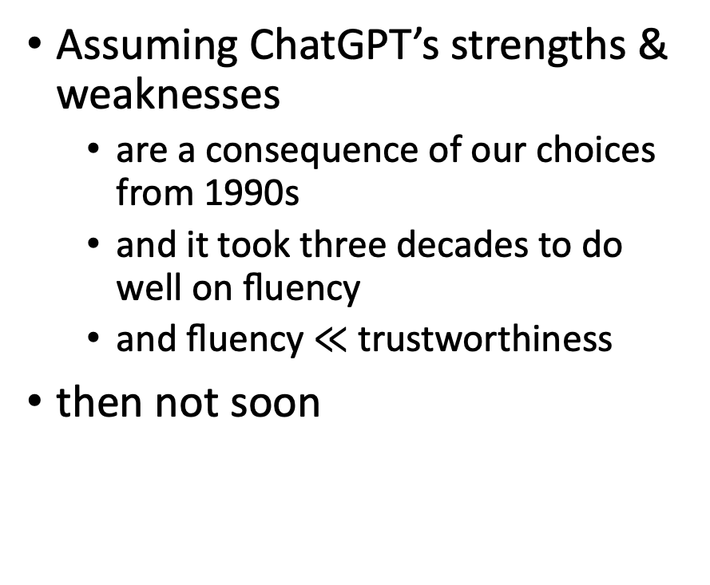
How Hard are Hallucinations?
Possible answers:
Soon: “See next release”
Eventually, but not soon:
“Next Year in Jerusalem”
History of Machine Translation
Never
Assuming ChatGPT’s strengths & weaknesses
are a consequence of our choices from 1990s
and it took three decades to do well on fluency
and fluency $≪$ trustworthiness
then not soon

Slide 43
Medium – Knowledge graphs

Slide 44
Introduction
Knowledge graph (KG) describes objects of interest and connections
Organizing data as nodes and edges
Examples
Microsoft Satori, Google Knowledge Graph, Amazon Product Graph
Knowledge bases (KBs): Yago, Freebase
Knowledge graph and knowledge base terms are used interchangeably

Slide 45
Introduction - II
How to identify nodes and derives edges
So far, most research on KGs/KBs use Wikipedia as source
Benefits: easy to read, easy to parse, Wikipedians
Drawbacks: coverage, outdated content, bias
What do we do when there is no Wikipedia?
… and there are plenty of examples in the real world
More specifically
KG is a repository of entities, types and relationships
KG defines entities, types, attributes, relations, provenance
KG is data
KG evolves and needs maintenance

Slide 46
KG vs DB
What’s the difference?
DB
Store data for a specific application purpose
Semantics understood by those who built it and use it
Tables, columns, attributes
KG
All we know about a slice of the world
Semantics understood and agreed by all stakeholders
Application independent
Things, not strings

Slide 47
Why we care?
Machine readable facts about a domain
Data can be used for different use cases
Separation of concerns

Slide 48
KGs in action
Semantic search
Going beyond 10-blue links
Understanding queries and documents
Document retrieval
Expansion
Language modeling
Entity retrieval
Recommendations
Question-answering
Data cleaning

Slide 49
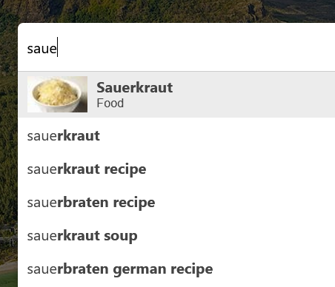
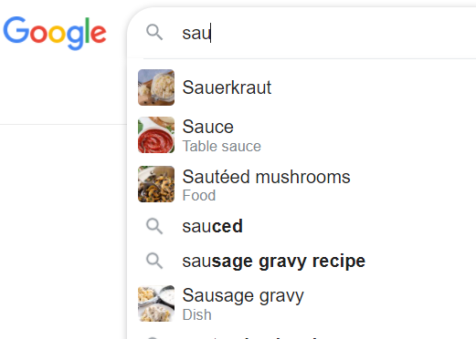
Example - Autocomplete

Slide 50
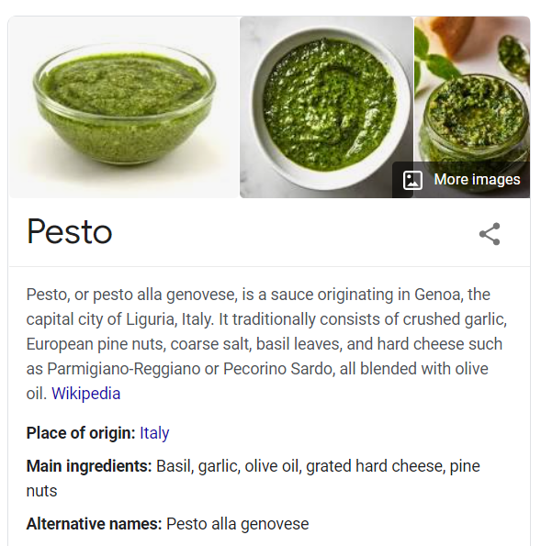
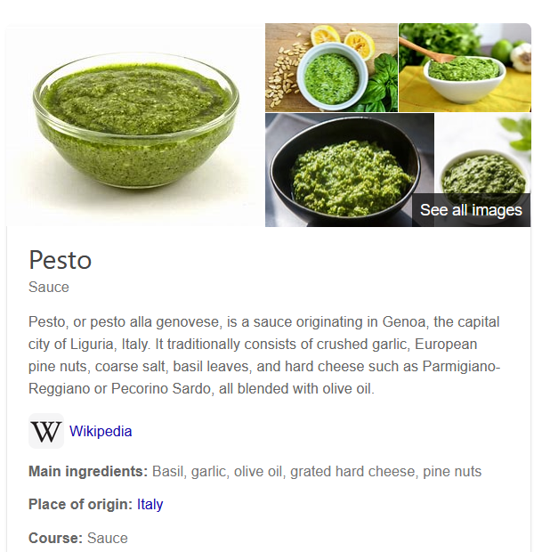
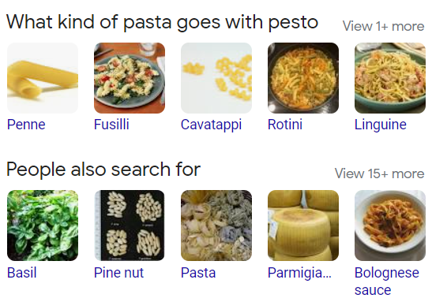
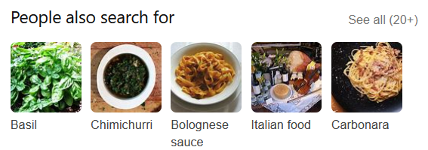
Example - Entity cards

Slide 51
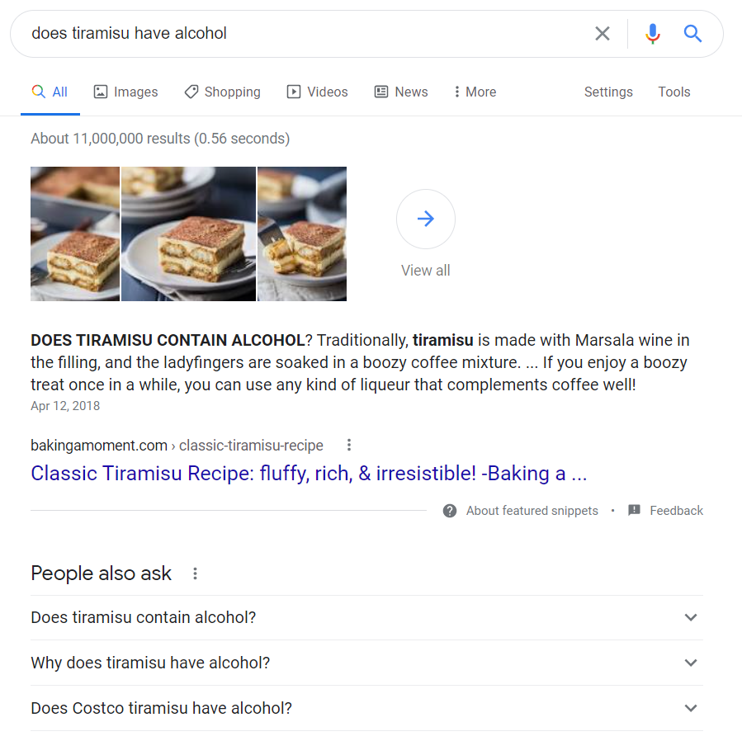
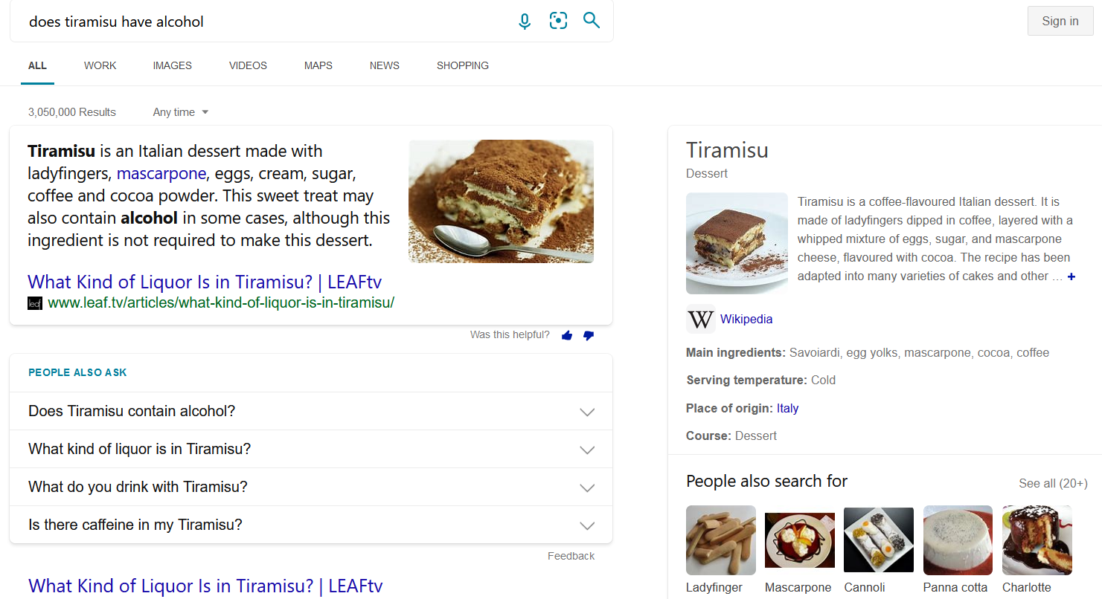
Example - answers

Slide 52
Main concepts
Entity
Object or concept in the real world that can be identified
Uniquely characterized by its name(s), type(s), attributes, and relationships to other entities
Named-entity
Specific entity for which one or many designators or proper names can be used to refer to it
Examples: Red Cross (Organization), California (Location), February (Date)
Unique identifier
An identifier for an entity is a string of chars that uniquely denotes this entity
one-to-one correspondence between each entity identifier (ID) and the object it represents

Slide 53
Main concepts - II
Types
Entities may be categorized into multiple entity types
Types can also be thought of as containers that group together entities with similar properties
Ontology
The process of describing the kinds, properties of and relationships on things in the world
Use the tools of logic to formalize this description
Taxonomies
Taxonomy is a directed acyclic graph, where the nodes are classes and there is an edge from class X to class Y

Slide 54
Main concepts - III
Names
Multiple entities may share the same name
These alternative names are called surface forms or aliases
Attributes
Different types of entities are typically characterized by different sets of attributes
Relationships
Relationships describe how two entities are associated to each other

Slide 55
Relationships and attributes
SPO
Subject-Predicate-Object
Example
<Tom Brady, place of birth, San Mateo>
<Tom Brady, member of sports team, Tampa Bay>
<Tom Brady, occupation, American football player>
<fettuccine, subclass of, pasta>
<fusilli, subclass of, pasta>
<linguine, subclass of, pasta>
<paella, country of origin, Spain>
<paella, has ingredient, chicken>
<paella, has ingredient, rice>

Slide 56
Data models
Direct edge-labeled graphs
RDF is an example
Graph dataset
Set of named graphs. Each named graph is a pair (graph id, graph)
Property graphs
Allows a set of (property, value) pairs and a label to be associated with nodes/edges
Common in graph databases

Slide 57
Data access
Querying
SPARQL
SQL
Raw data
Materialization
Publish high quality data
Search & Browse UI

Slide 58
Information needs
Keyword queries
Free text queries
Structured queries
SQL, SPARQL
Keyword++
Queries with filters or facets
Natural language
Natural language queries, questions
Zero queries
You are the query

Slide 59
How do we build one
Manually
Experts, crowdsourcing
Automation
Generated from input sources
Information extraction
Representation
Entity extraction
Unstructured text
Structured KG
Relation and attribute extraction

Slide 60
Many choices
Semantic Web-like
RDF, OWL, SPARQL
Key-values
Text files, JSON
RDBMS
Tables, columns, SQL
Hybrid
Your favorite combination

Slide 61
Input sources
Data
Wikipedia, catalogs, web pages, query logs, etc.
Importance of top-tier sources
Authoritative content, high coverage, clean representation
Domain specific
Pre-existing categorization
Potentially useful
Alignment

Slide 62
Entity discovery
NER detects mentions of entities and assigns types
Part of your typical NLP toolkit (e.g., NLTK, Stanza, GATE)
Popular types: People, places, organizations, date, etc.
Dictionaries
Abbreviations (Apple, Apple Inc.)
Acronyms (MS, Microsoft)
Stage name (Lady Gaga, Stefani Joanne Angelina Germanotta)
Pattern-based methods
Hearst patterns; co-occurrence
“such as”, “X like Y”, “X and other Y”, “X including Y”

Slide 63
Entity discovery - II
ML
CRF
LSTM models
Embeddings
Word embeddings are computed from co-occurrences and neighborhoods of words in large corpora
Words are highly related if they are used in similar context
Taxonomies from catalogs, networks and user behavior
Wikipedia categories
Tagging systems
Query logs and clicks

Slide 64
Entity linking
Recognizing entity mentions in text and linking them to the corresponding entries in a KG
Assume a KG with existing entities
What’s the difference between NER and EL?
NER recognizes entities and assigns an entity type
EL recognizes entities and assigns an entity id
Importance of having an identifier management system

Slide 65
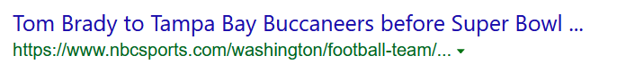
Entity linking - example
Tom Brady (player)
Tom Brady (director)
Super Bowl 2021
Super Bowl 2020
…
Tampa Bay (Location)
Tampa Bay (Buccaneers - NFL)
Tampa Bay (Lightning - NHL)
Tampa Bay (Ray - MLB)
Tampa (Florida)
Tampa (Kansas)
Tampa Bay Buccaneers (NFL team)

Slide 66
Entity linking – components
Mention detection
Identification of text snippets that can potentially be linked to entities
Using dictionary of entity names and variations
Candidate selection
Ranked list of candidate entities is generated for each mention
Disambiguation
The best entity (or none) is selected for each mention using context (if available)
Ranking problem
Entity annotations

Slide 67
Entity matching
Compute equivalence class
Also known as duplicate detection or record linkage
Name similarity
String similarity
Context similarity
Importance of proximity
Mention-entity popularity
Popularity of an entity
NEMO (Named Entities Made Obvious)
The best evidence for entity disambiguation is provided by the set of co-occurring entities

Slide 68
Attributes and relationships
Pattern-based
Regex
Rule-base extraction
Extraction from semi-structured content
DOM trees
Web tables
Information extraction
Extract (entity-type, alpha, entity-type)
Infoboxes are great if you have them

Slide 69
KG Curation
Quality
Precision, recall
Crowdsourcing
Human in the loop
KG life cycle
Provenance metadata (source, timestamp, extraction method)
Versioning
Twitter CEO (Jack -> Parag -> Elon)
Maintenance

Slide 70
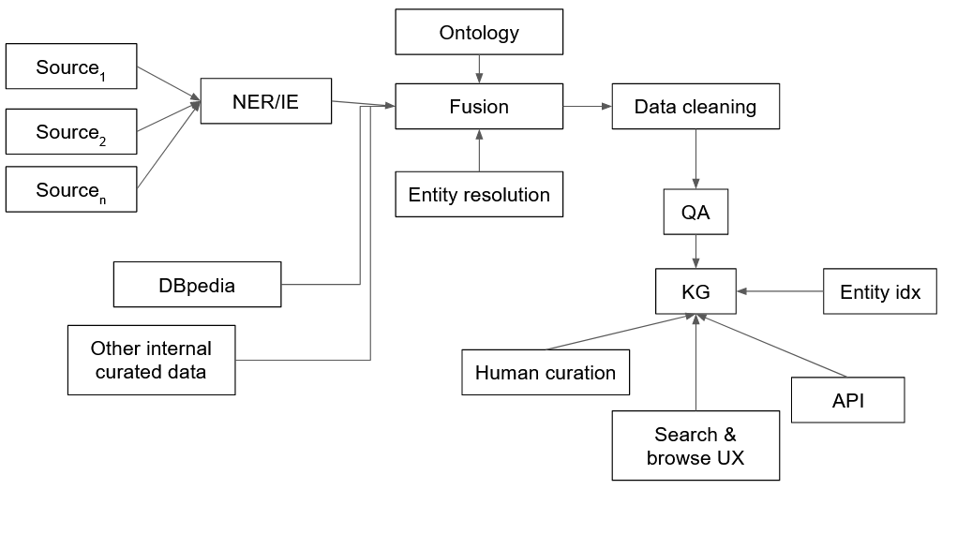
Architecture for KG construction

Slide 71
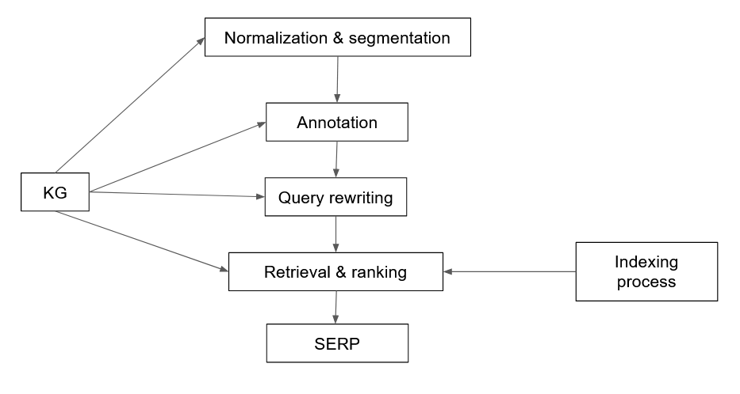
Where is the KG?

Slide 72
Representation
Unique problem
Entities in KG have no textual representation, apart from their names
We can run SPARQL queries but how do we add the IR part?
Predicate folding
Build a textual representation for each entity by considering all triples
Grouping predicates together into a small set of predefined categories
From SPOs triples to a structured document

Slide 73
Predicate folding - example
<spaghetti carbonara, instance_of, recipe>
<spaghetti carbonara, has_ingredient, spaghetti>
<spaghetti carbonara, has_ingredient, pancetta>
<spaghetti carbonara, has_ingredient, eggs>
<spaghetti carbonara, has_ingredient, parmesan>
<spaghetti carbonara, recipe_cuisine, italian cuisine>
<spaghetti carbonara, serving_size, 4>
<spaghetti carbonara, calories, 510>
<spaghetti carbonara, cook_time, 25min>
Name | spaghetti carbonara
Ingredients | Spaghetti, pancetta, eggs, parmesan
Attributes | italian cuisine, serves 4, calories 510, cook time 25min
Related entities | spaghetti aglio e olio, fettuccine alfredo

Slide 74
Entity retrieval
Field search retrieval
Linear combination of matching functions
Can use LTR to learn weights

Slide 75
Document retrieval
Preprocessing
Documents are preprocessed with EL + additional information obtained from KG
Query annotation
Query processed with EL
Expansion
KG feedback: query is issued against an index of a KG in order to retrieve related entities
Corpus-based feedback

Slide 76
Semantic search
Understanding information needs
Query classification
Assign a query to one or multiple pre-defined categories
Query intent classification (Broder)
Query annotation
Generate semantic markup for a query
Query segmentation: group terms into phrases
Query tagging (POS, NER)

Slide 77
EL in queries
Problems
Queries are very short
Limited context, or none at all
Online process under time constraints
Components
Mention detection
Candidate ranking
Interpretations: query may have more than 1 interpretation

Slide 78
Using entities for search
Query assistance
Auto-complete
Specific subset of queries that can be decomposed into entity and refiner components
Query recommendations
Entity cards
Summaries and facts
Entity recommendation
Entity based
Query based
Explanations

Slide 79
Domain specific KGs: healthcare domain
Scientific medical knowledge
Existing taxonomies and data sources
Examples
SNOMED (Systematized Nomenclature of Medicine)
RxNorm (medications available on the US market)
MeSH (Medical Subject Headings)

Slide 80
Challenges
Very sensitive data
EMR (Electronic Medical Records)
Clinical relevance
Vocabulary mismatch
Patient describing a symptom
MDs describing a diagnosis
Data labeling and curation

Slide 81
How to bootstrap?
No single approach to build a KG
Research and engineering problems
Iterative development cycle
Content
Infrastructure
Applications

Slide 82
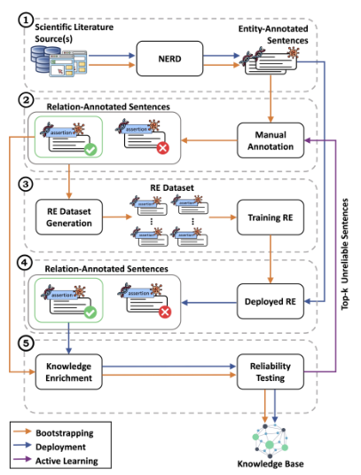
CORE (Collaborative Oriented Relation Extraction)
KG generation system
Combination of automated ML-based methods and domain experts
Modular architecture that can be easily modified
Reliability tests
Active learning process make the system suited to iterative
Versioning
S. Marchesin et al. "Building a Large Gene Expression-Cancer Knowledge Base with Limited Human Annotations" Database, 2023

Slide 83
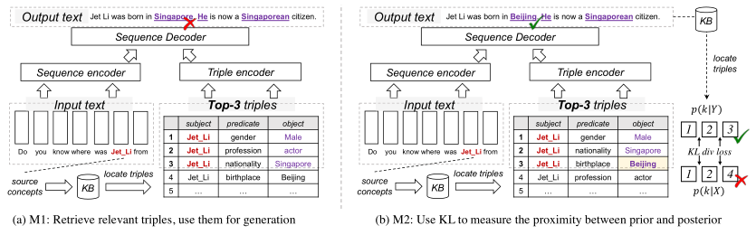
Knowledge-enhanced generation with KGs
Design Supervised Tasks around KG
Discover the dependencies of elements within a sequence
Retrieve relevant triples, then using them for generation
Using KL to measure the proximity between prior and posterior distribution
Selecting KG or facts in a KG
W. Yu et al. "A Survey of Knowledge-Enhanced Text Generation" ACM Computing Surveys 2022

Slide 84
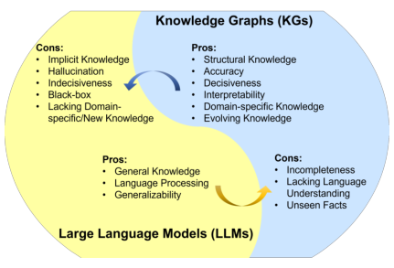
Combining KGs & LLMs
LLMs lack of factual knowledge
LLMs memorize and knowledge in a training set
No interpretability
KGs are difficult to construct and maintain
KGs are domain specific
S. Pan et al. "Unifying Large Language Models and Knowledge Graphs: A Roadmap" arxiv.org/abs/2306.08302

Slide 85
KG-enhanced LLMs
KG-enhanced LLM pre-training
Training objective
LLM inputs
Fusion models
KG-enhanced LLM inference
Dynamic fusion
Retrieval augmented
KG-enhanced LLM interpretability
Probing and analysis

Slide 86
LLM-augmented KGs
Embedding
Text encoders
Joint text and KG embeddings
Completion
Construction
Entity discovery
Relation extraction
Coreference
Distilling KGs from LLMs
KG-to-text generation
LLM-augmented KG question answering

